Slide 1
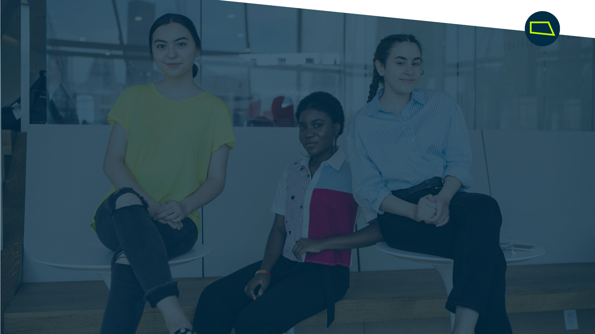
BACKCOURT - Twitter Sports Tourism Sentiment Analysis
AI Studio Final Presentation
Break Through Tech AI @ MIT
December 6, 2024

Slide 2

Introductions

Slide 3

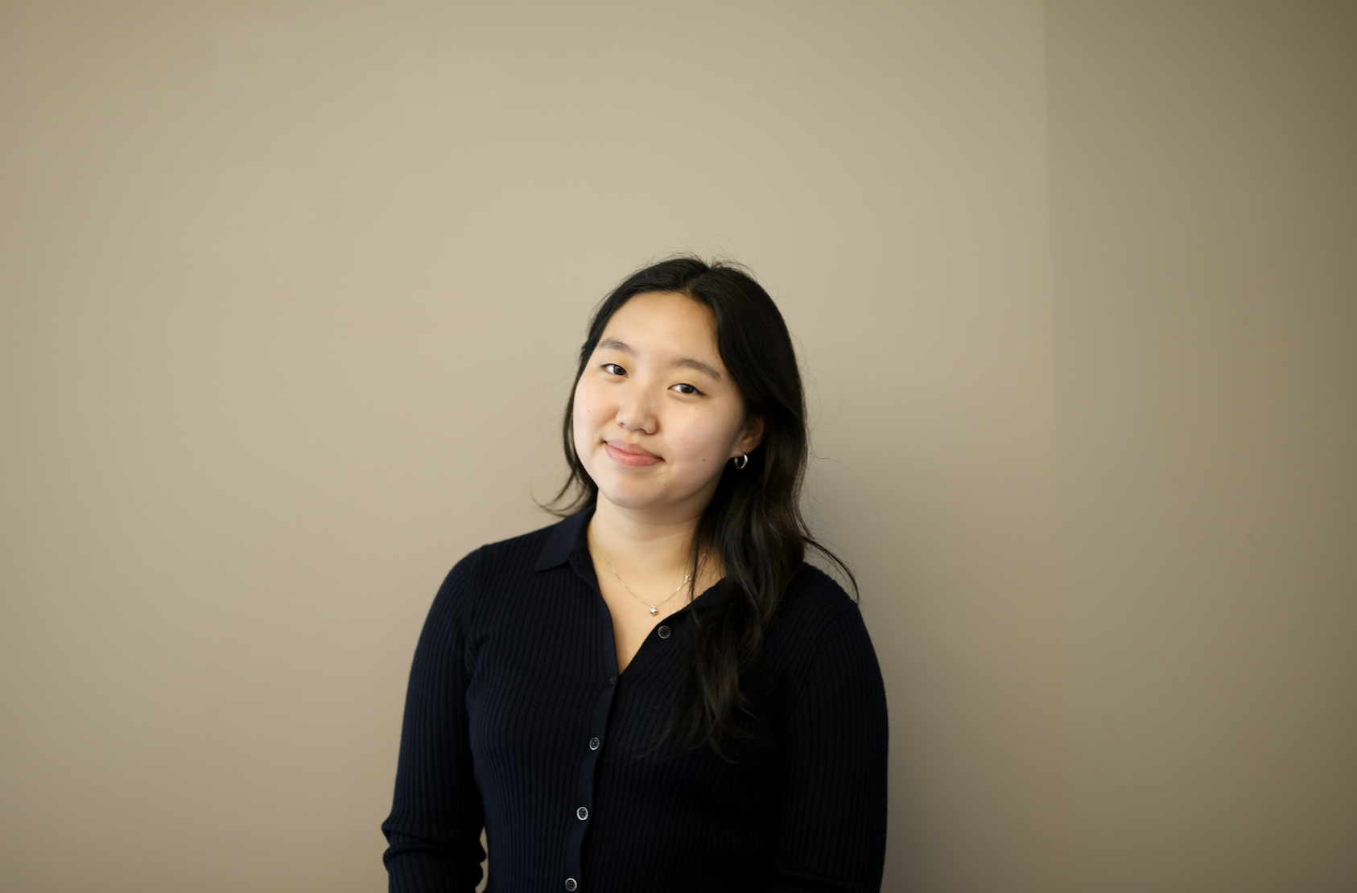
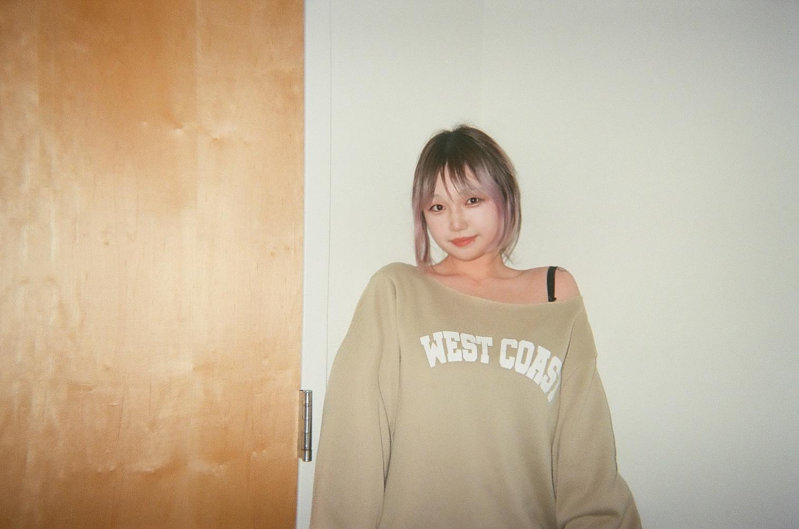
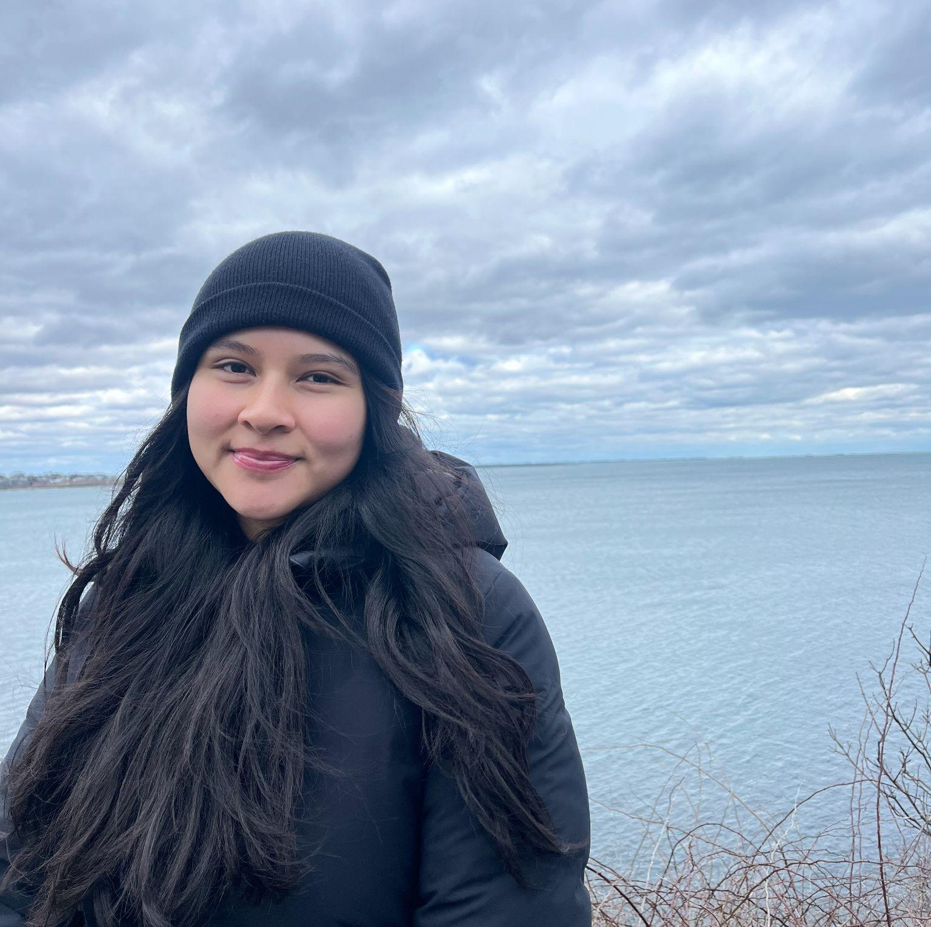
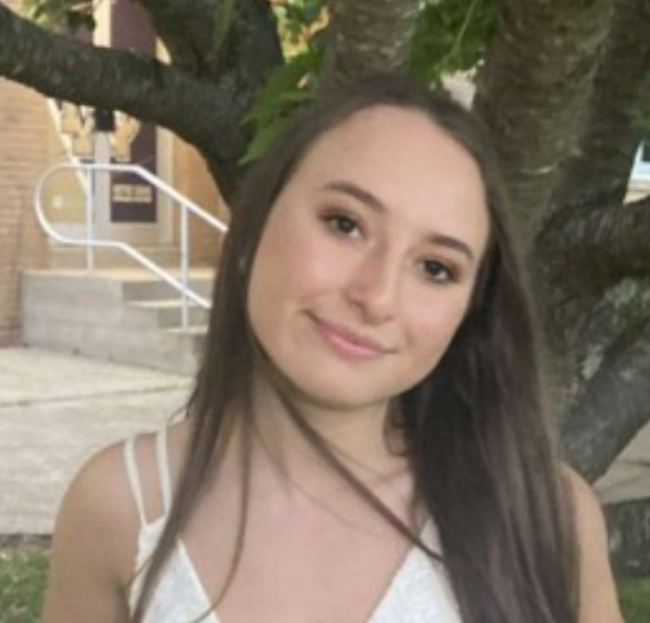
Meet Our Team!
<insert jpg>
Claire Lee Tufts University
Nana Li Brandeis University
Vanessa Pliego Smith College
Lindsey Blau University of Massachusetts, Amherst

Slide 4
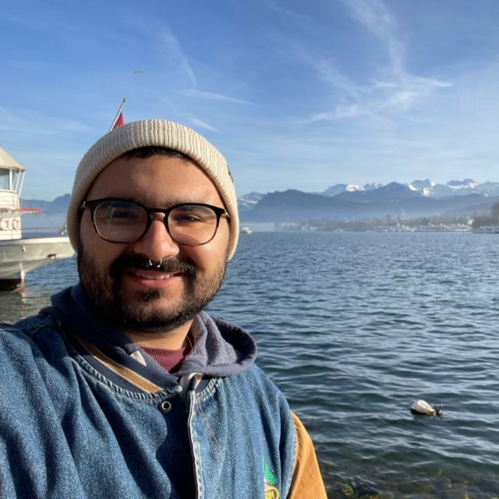

Our AI Studio TA and Challenge Advisor
<insert jpg>
George Abu Daoud AI Studio TA
Darren Douglas Challenge Advisor
Notes:
Say Thanks!!!!!
A huge thank you to our TA George and our Challenge Advisor Darren for their guidance and support on this project. We could not have done this without you guys!

Slide 5
Presentation Agenda
BACKCOURT Introduction
Project Overview
Data Understanding and Data Preparation
Modeling and Evaluation
Final Thoughts
Questions

Slide 6
BACKCOURT Overview

Slide 7

BACKCOURT and Sports Tourism
Sports Tourism: the travel experiences of tourists who observe or participate in a sport event
BACKCOURT’s mission: spotlight how sports tourism can elevate local economies
Caribbean based focus
BACKCOURT incorporates sports tourism and business, launched in 2023
53% open rate, 20% monthly growth rate, 8% free-to-paid conversion rate
Generating 22K+ article views since March 2024
Notes:
Sports tourism is a tourism activity that encompasses the travel experiences of tourists who observe or participate in a sport event.
Generally involves commercial and non-commercial activities on a competitive nature
Involves finding discounted flight, hotel, and ticket packages, etc
BACKCOURT is a business that provides insights into the $683 billion dollar sports tourism industry
BACKCOURT’s mission: To spotlight how sports tourism can elevate local economies, starting with the Caribbean (which is not a focus of our sentiment analysis).
BACKCOURT is a sports business newsletter launched in March 2023, pivoted to sports tourism in January 2024, incorporated in March 2024

Slide 8
AI Studio Project Overview

Slide 9
“
Develop a machine learning algorithm to analyze public reaction and sentiment around 2 sports experiences — FIFA World Cup 2018 in Russia and FIFA World Cup 2022 in Qatar

Slide 10
Our Goals
Generate individual insights into the public reactions of the two World Cup Events
Compare insights between the two World Cup Events
analyze any outside factors that may contribute to a difference in public sentiment
Conduct analysis to create actionable insights for marketers and event organizers
Notes:
Generate individual insights and analysis of the sentiment and public reactions of the two World Cup Events
Compare insights between the two World Cup Events and analyze any outside factors that may contribute to a difference in public sentiment between the two events
Use analysis to create actionable insights for marketers and event organizers

Slide 11
Business Impact
Elevate BACKCOURT’s status as a trusted resource in the sports tourism industry
Provide Insights: showcase what is important in sports tourism
Lay foundations for collaboration with tourism and sports organizations
Notes:
Position BACKCOURT as a trusted resource in the sports tourism industry
Provide insights into what aspects of sports tourism experiences are most enjoyed and what experiences need improvement
Allow BACKCOURT to effectively work with tourism boards and sports organizations to create better sports tourism operations

Slide 12
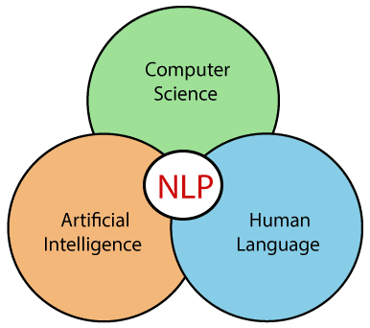
Our Approach: Natural Language Processing
Kaggle data pre-processing
Use data engineering, NLP, clustering, and topic modeling skills
Create subsets that focus only on relevant tweets:
tweets with a large number of likes and retweets
Use sentiment analysis model libraries to generate a sentiment score
Compare the scores between the two data sets
Notes:
Use Kaggle Datasets and inspect the data, seeing what keywords are associated with the two World Cup Events
Use data engineering, NLP, clustering, and topic modeling skills
Transform the datasets into subsets that focus only on relevant tweets: tweets with a large number of likes and retweets
Use sentiment analysis model libraries to generate a score that ranks how positive the overall tweets are
Compare the scores between the two data sets and then conduct a thorough analysis on the difference and comparison between the two models

Slide 13
Our Timeline
Final Touches + Presentation
Finish analysis, come up with actionable items for BACKCOURT, and final presentation
Project Initialization
Focus on understanding BACKOURT, sports tourism, and general terminology related to the World Cup Events. Set up project workspaces.
Model Tuning and Evaluation
Develop the models for both data sets, fine tune both models, evaluate results
September
November
August
October
December
Data Cleaning and Preparation
Load data into Google Colab, clean data (get rid of non-English tweets and characters), create subsets of relevant tweets
Comparative Analysis and Insights
Analyze and gain insights on each individual model, then perform a comparative analysis between the two models. Develop business insights on how we can use what we learned to contribute to BACKCOURT’s position in the sports tourism industry

Slide 14

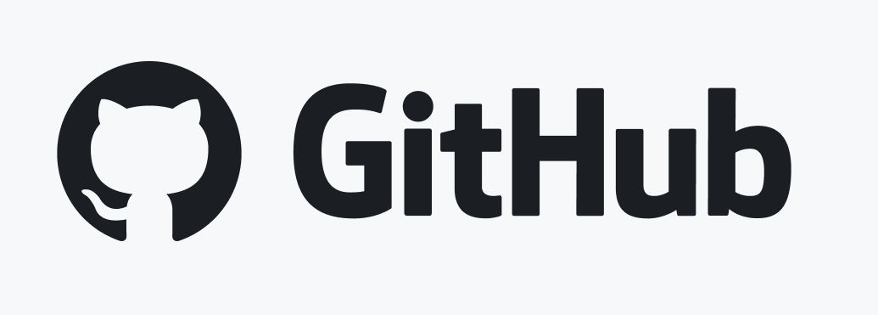

Resources We Leveraged
Google Colab
Trello
GitHub
Pandas
NLTK Library, SentimentIntensityAnalyzer
Matplotlib
Openai API for Sentiment Analysis
Notes:
We used Google Colab for collaborative coding, trello for project management, GitHub for code-sharing and a project repository. And we used NLTK Library, SentimentIntensityAnalyzer, Matplotlib, Openai API for Sentiment Analysis all for the actual sentiment analysis itself

Slide 15
Data Understanding & Data Preparation

Slide 16
Data description & cleaning
Two datasets will be used for sentiment analysis
FIFA World Cup data from 2018
FIFA World Cup data data from 2022, Day 1*
2018 FIFA data:
Originally 16 columns, 530k rows
Interested in Tweet column for analysis
Cleaned data → 11 columns, 17,313 rows
Filtered out NA values
Subsetted the dataset to only include dates that start with 2018-07-15
Removed unnecessary columns(UserMentionNames, UserMentionID, ID, Followers, and Friends)
Excluded any rows that did not have "en" in the 'lang' column
For comparison reasons, new data frame was created and filtered to include data for one day of World Cup (July 2nd, 2018)
11 columns, 12,148 rows

Slide 17
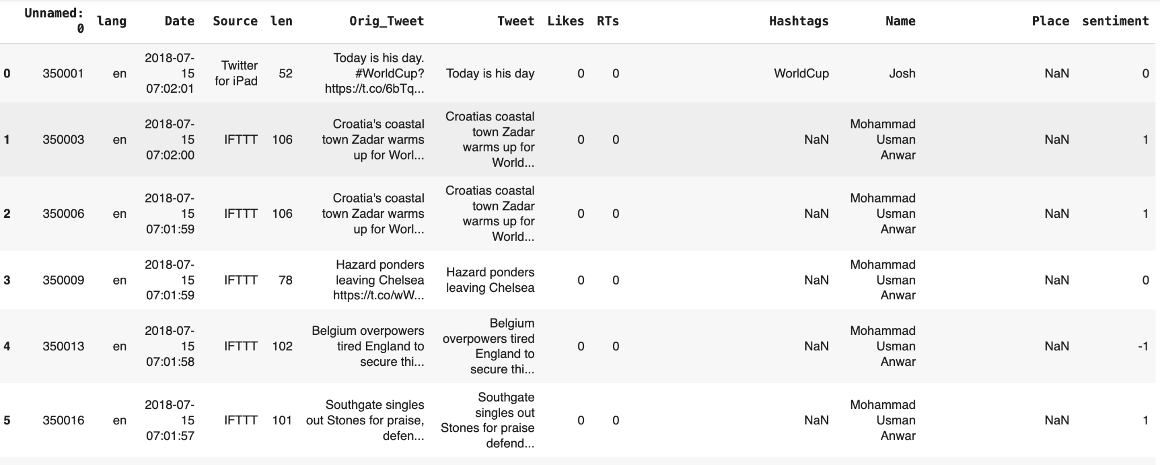

Source: 2018 Fifa dataset
created a new column "sentiment" that has values of 1 (positive), 0 (neutral) , or -1 (negative) based on the sentiment of the content in the "Tweet" column
Only English tweets

Slide 18
Data description & cleaning pt.2
2022 FIFA data:
6 columns, 22.5k rows
Already contains a sentiment score for tweets + cleaned dataset
Modified data
Using Sentiment column, mutated df to create new column to transform sentiment into numeric representation. → ‘positive’ = 1, ‘neutral’ = 0, ‘negative’ = -1
7 columns, 22.5k rows

Slide 19
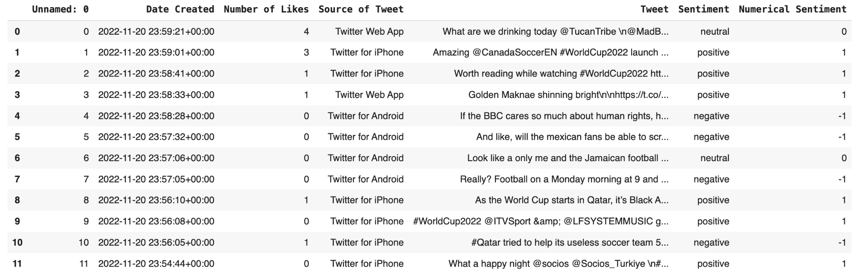
Source: 2022 Fifa dataset
Data is limited to November 20th,2022
Sentiment column that would be used in drawing comparisons w/ 2018 data

Slide 20
Modeling & Evaluation

Slide 21
Sentiment Analysis
Objective: To classify tweets based on sentiment (positive, negative, neutral) using a machine learning approach.
Methodology: VADER (Valence Aware Dictionary and sentiment Reasoner) from the NLTK library
VADER: lexicon-based sentiment analysis model designed especially for the social media text
VADER uses a pre-defined list of words and phrases that have been assigned sentiment scores, reflecting their emotional intensity (positive, negative, or neutral). The lexicon is designed to capture the sentiment expressed in social media, taking into account various aspects such as slang, acronyms, and emoticons.

Slide 22
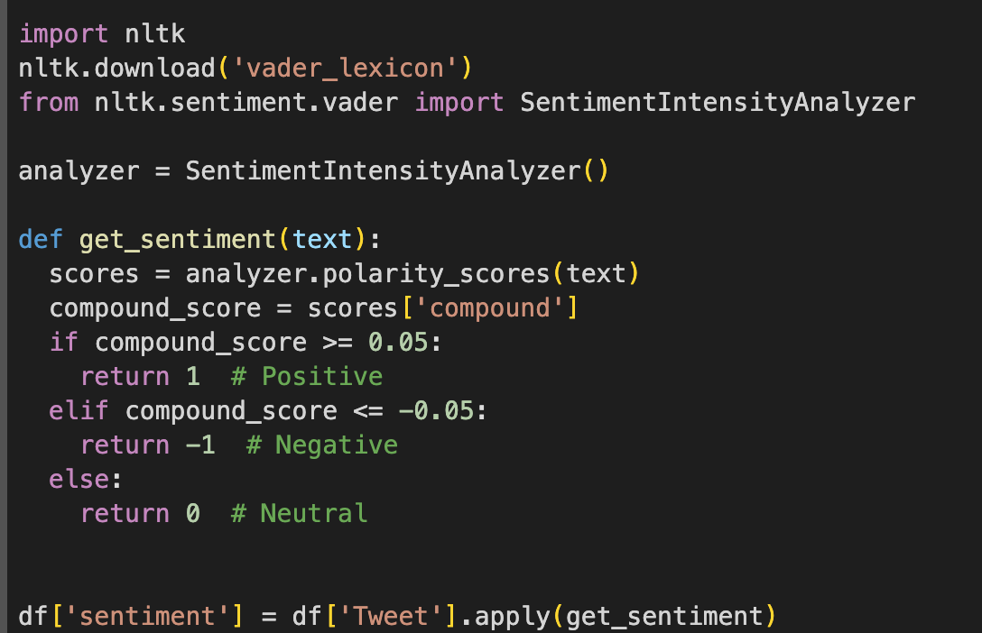
[Insert image and/or code snippet]
VADER

Slide 23
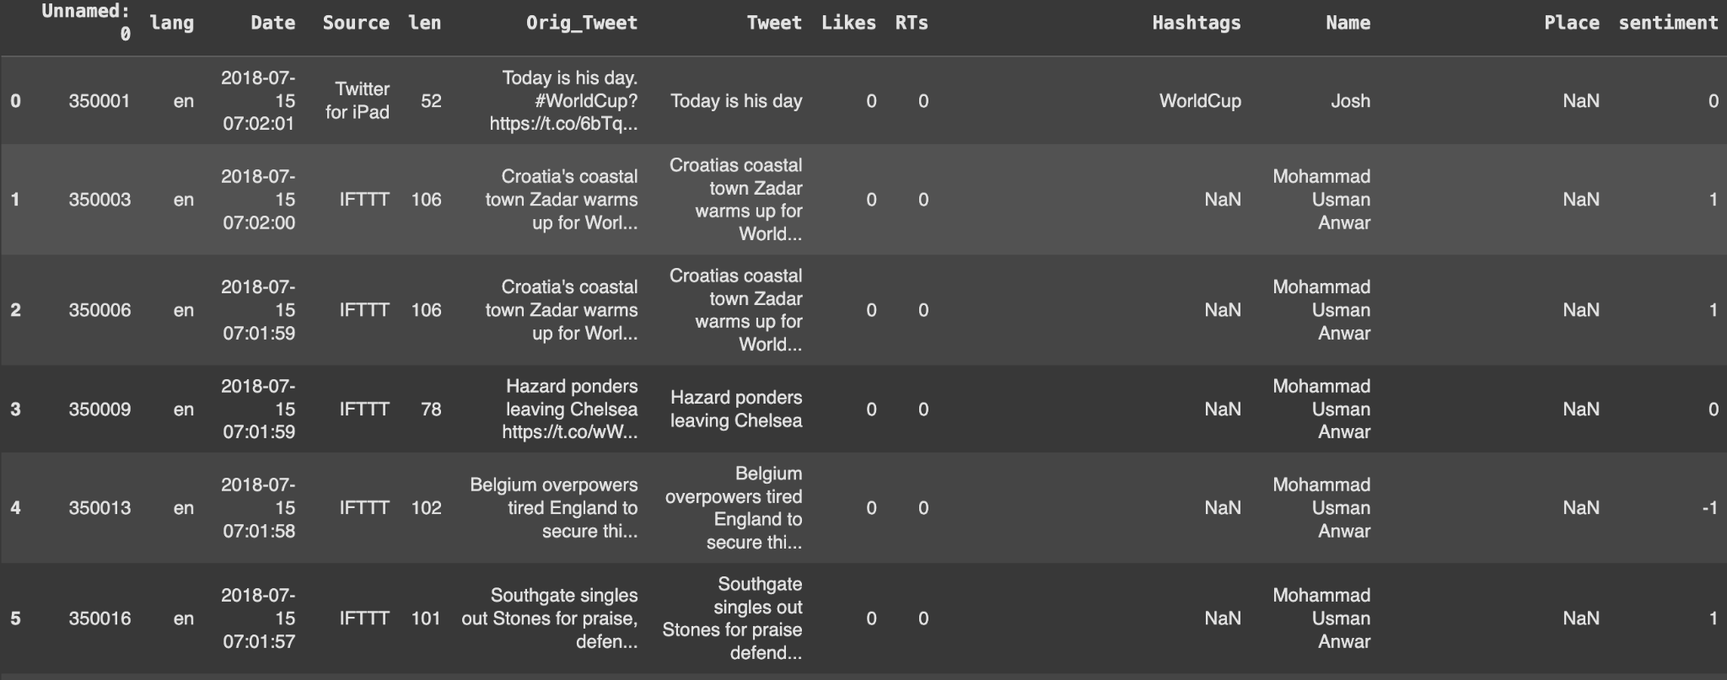
[Insert image and/or code snippet]
Sentiment Analysis
Result returned by sentiment analysis

Slide 24
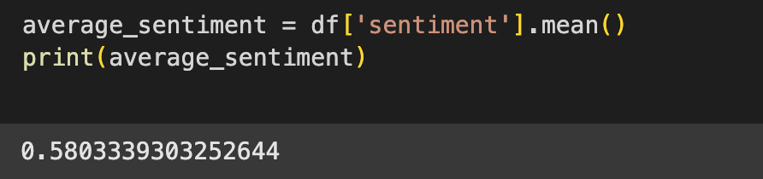
[Insert image and/or code snippet]
Sentiment Analysis

Slide 25
Model Comparison
Model Name | Description | Results | Pros | Cons
VADER | Sentiment analysis model designed especially for social media texts | Score of positive or negative | Specialized on social media | Limited Contextual Understanding
BERT(Bidirectional Encoder Representations from Transformers) | BERT is a deep learning model developed by Google that has become a standard in natural language processing tasks | Score of positive or negative | Handling of long texts | Long Inference Time

Slide 26
Insights and Key Findings
2018 FIFA World Cup data analysis has shown
An average of ~42% overall positive sentiment toward the World Cup
While this is not low, we believe that external factors such as location + accessibility to location, stadium venue, ticketing options, etc., could be responsible for results.
2022 FIFA World Cup dataset
An average of ~12% overall positive sentiment toward the World Cup, DAY 1*.
This was expected since data is limited to DAY 1 of WC.
To accommodate for 2022 dataset, we calculated overall positive sentiment for 1 day in 2018 dataset.
An average of ~31% overall positive sentiment for July 2nd, 2018. → drop in 2022 fan average positive sentiment by 19%.
Greater Impact
Apply our sentiment analysis to any emerging market (i.e. the Caribbean, Middle East)
Provides real-time insights into public opinion during sporting event
Negative sentiment flags areas to improve (hospitality, infrastructure, etc.)
Organizers can adapt strategies to enhance fan experiences

Slide 27
Final Thoughts

Slide 28
What We Learned
Sentiment Analysis
Majority of our team did not have prior experience working with sentiment analysis models
Understand how sentiment and public engagement go hand-in-hand
Complicated data understanding and Preparation
Had to clean and filter a lot of data
Removing repeat tweets (some with +100 repeats)
Accept only English tweets
Adapting to complications w/ datasets
Our original 2022 dataset was scrapped → data was not in time frame of interest
2022 World Cup dataset had to be reevaluated in order to meet team goals.

Slide 29
Potential Next Steps
Analyzing more games leading up to the World Cup Finale
Semifinals, quarterfinals, etc
Varied datasets
Use Carribean sports datasets
Cricket, Basketball
Use non-English tweets
Refer to other social media platforms like Instagram or Facebook
Combine our results with advertising strategies per event
Allow businesses to make informed decisions on sponsorships
Explore how sentiment correlates with ticket sales and merchandise revenue

Slide 30
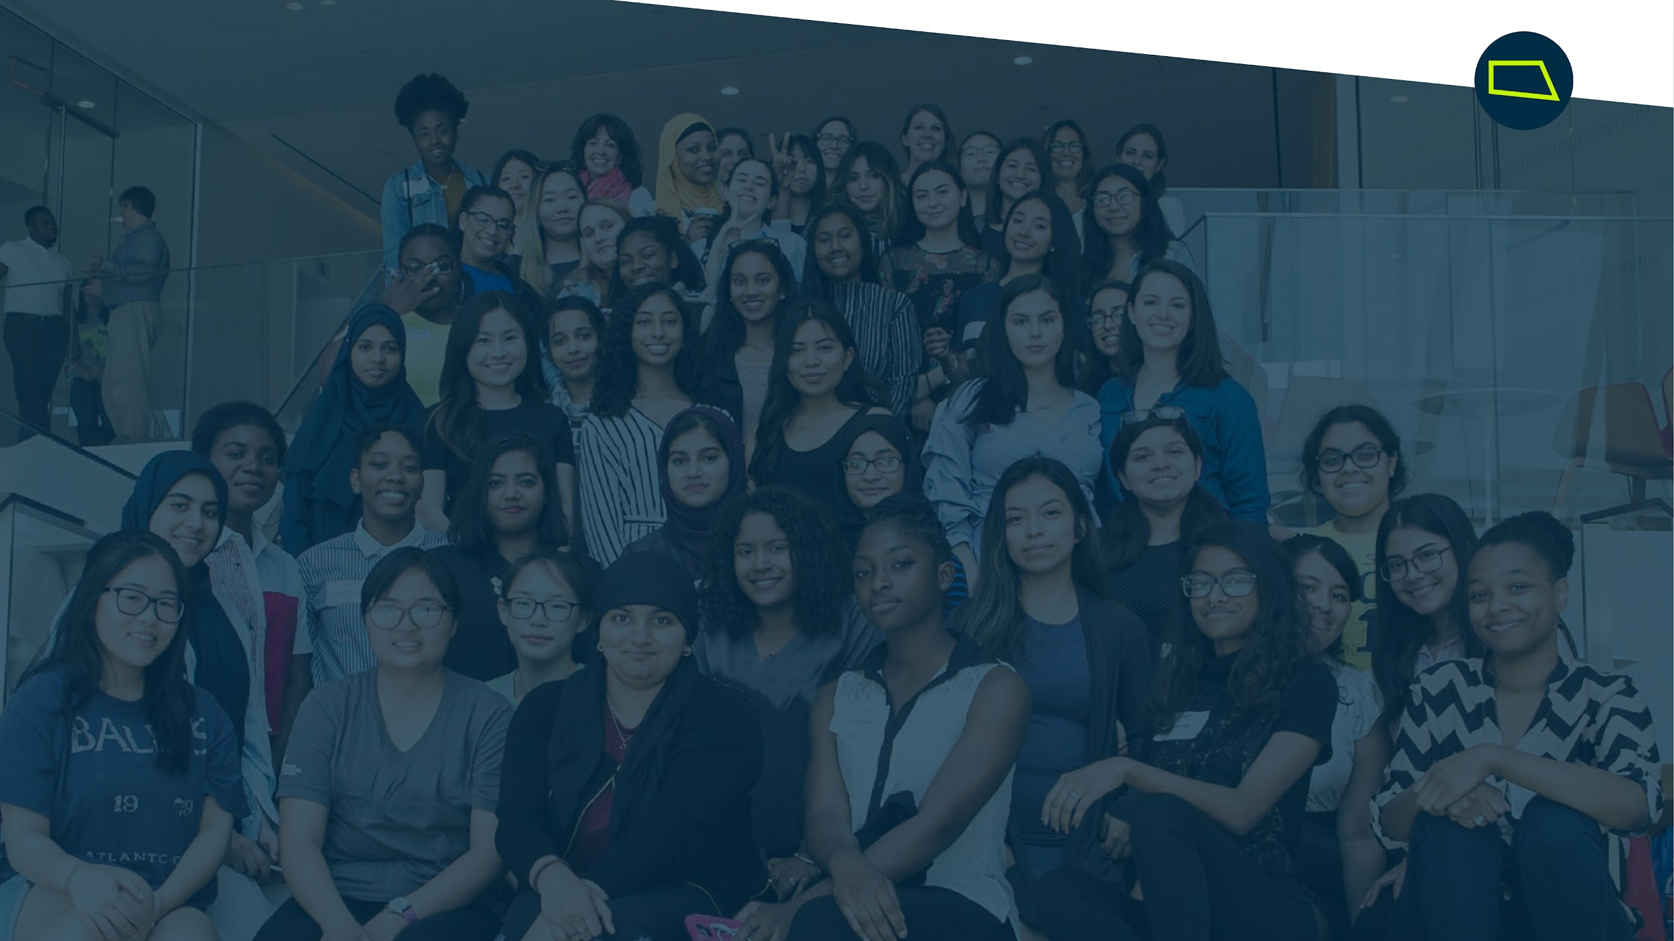
Questions?

